Slide 1
Economic Risk in Ghana
Presentation by Likam Kyanzaire

Slide 2
Economic Risk?
“These typically refer to features of an economy that increase
vulnerabilities to an external shock, or structural fundamentals
and policy that can be the basis of home-grown payments crises”
(Toksoz, The Economist)

Slide 3
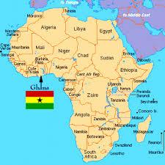
Ghana Overview
borders Togo, Cote d'Ivoire, and Burkina Faso. It has a population of about 29.6 million (2018). democracy under a multi-party system, with its independent judiciary winning public trust. Ghana consistently ranks in the top three countries in Africa for freedom of speech. Factors such as these provide Ghana with solid social capital (World Bank)

Slide 4
Economic History
13th Century - 1867
1867 - 1957
Asante Empire
Gold, nuts and slaves
British colony (Gold Coast)
Cacao trees from Americas
Displacement of local textiles
Palm oil, gold

Slide 5
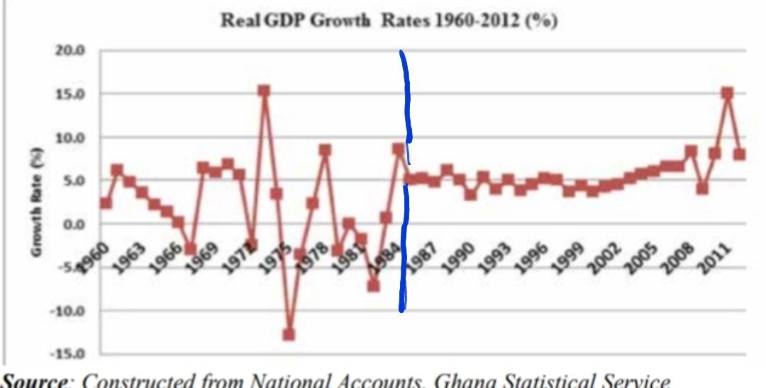
Modern Ghana
Liberalized Development (1980s – present)
National Development
(1957 – 1980s)

Slide 6
Modern Ghana
National Development
Liberalized Development
National independence (1957)
State led development (1960s)
Political coup (1966) (1972) (1981)
Liberazation of economy (early 80s)
Strucutral Adjustment Programs (1986)
Oil exports (2011)

Slide 7
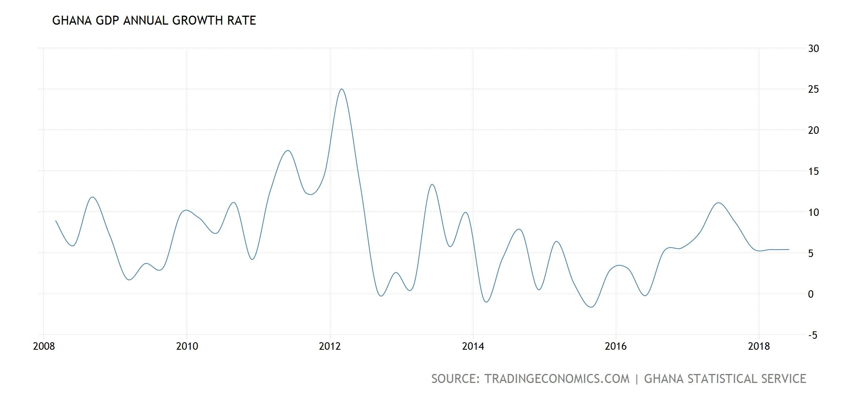
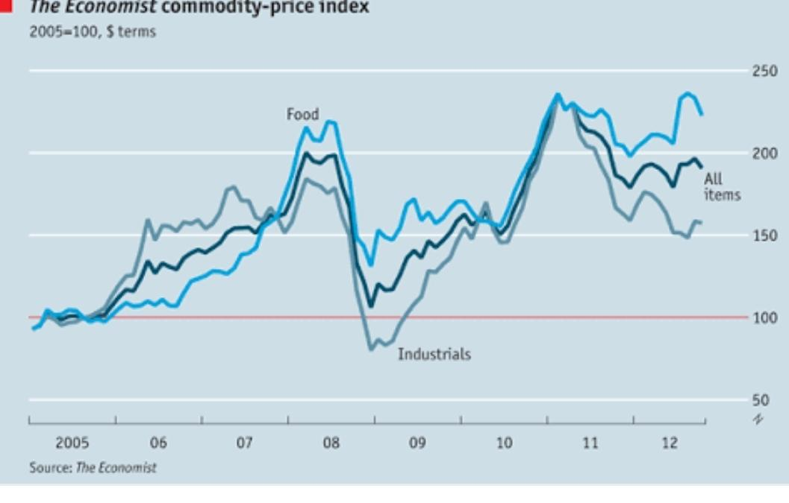
The 21 Century Economy
Growth in GDP from:
Commodity supercycle
Smart economic policy
Government debt from:
New loans from China
Electoral spendings

Slide 8
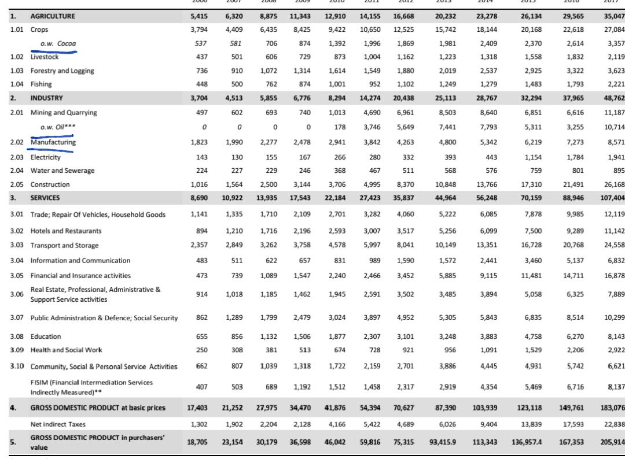
The Economy Part 2
GDP - composition by sector:
agriculture: 18.3%
industry: 24.5%
services: 57.2% (2017 est.)

Slide 9
Political Economic Framework:
Post Keynesian
concerned primarily with the depiction of an economic system expanding over time in the context of history
investment and savings behavior that this influence of past history and expectations about the future is felt

Slide 10

Political Economic Framework II
Macroeconomic disequilibrium:
  Investment
  Current Account
  Working Age Population
  Productivity

Slide 11
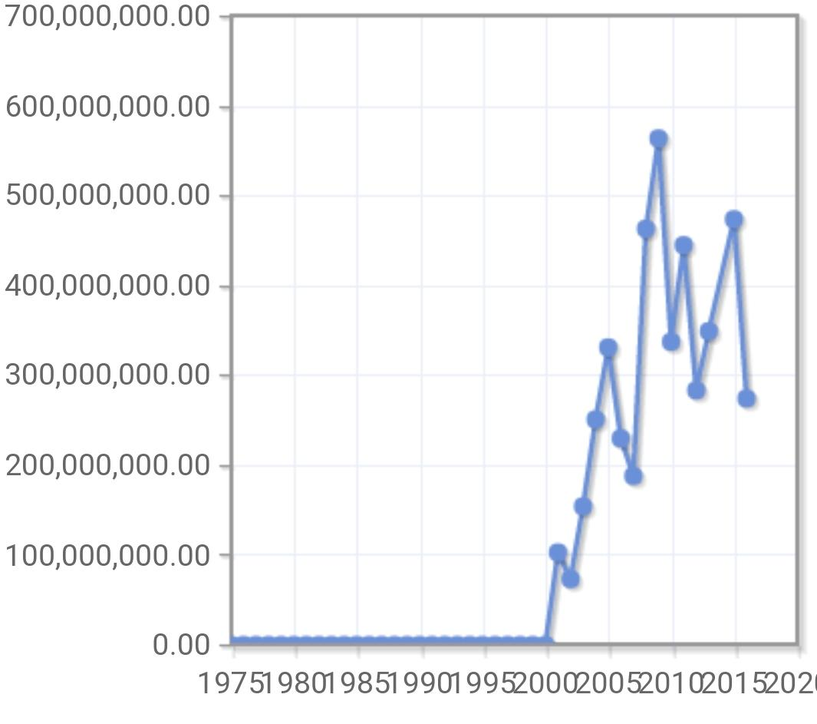
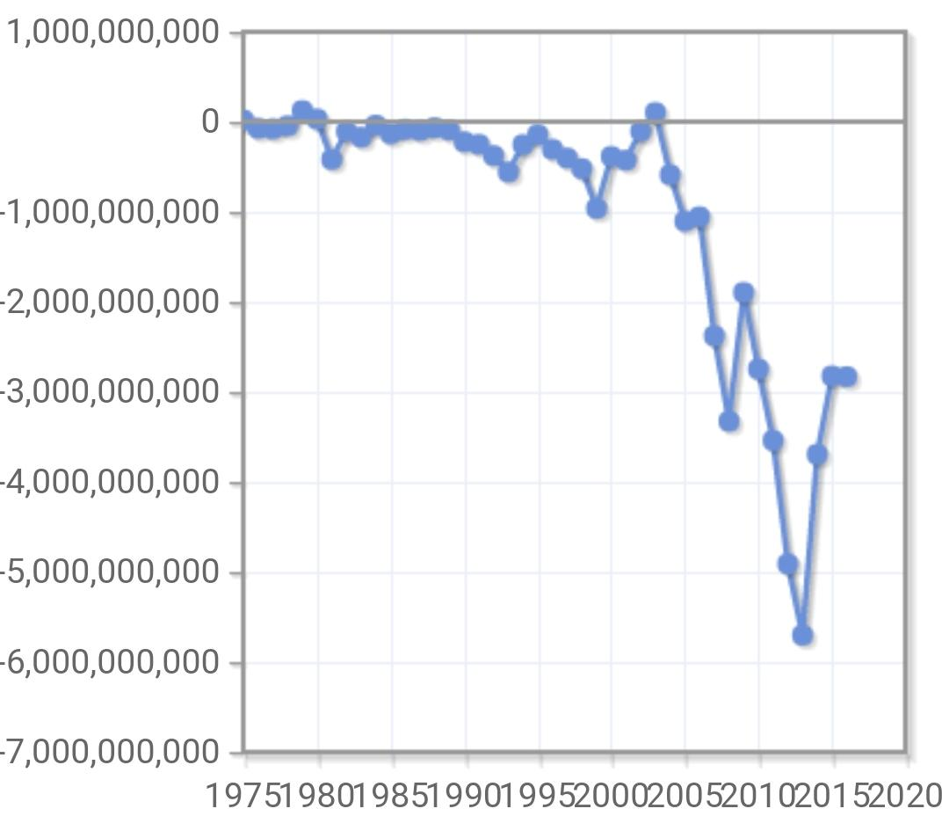
External : Balance of Payments

Slide 12
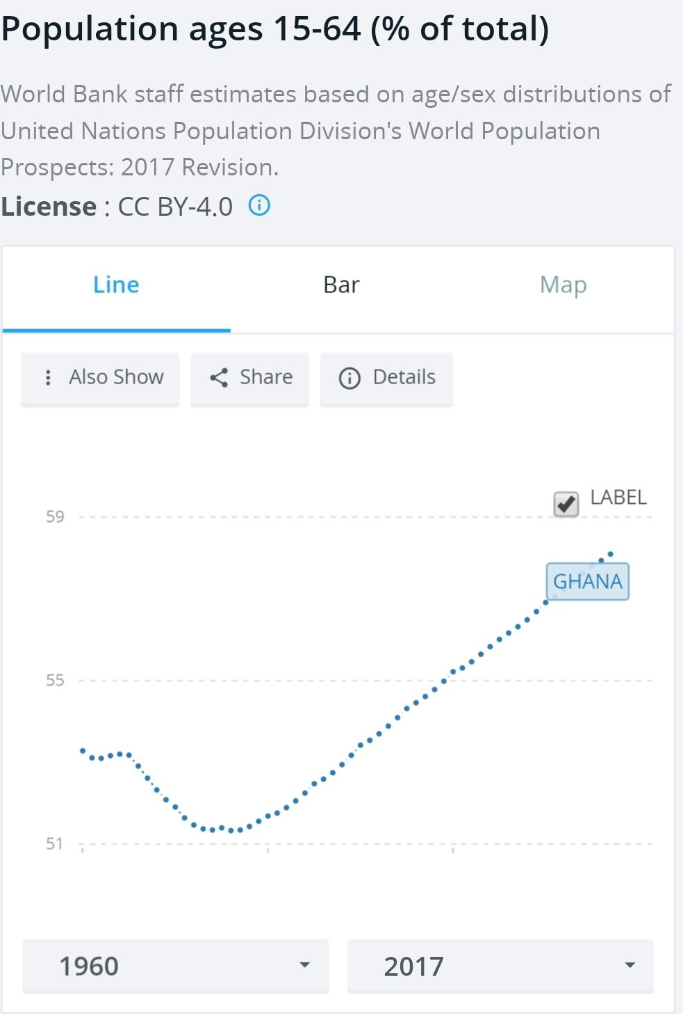
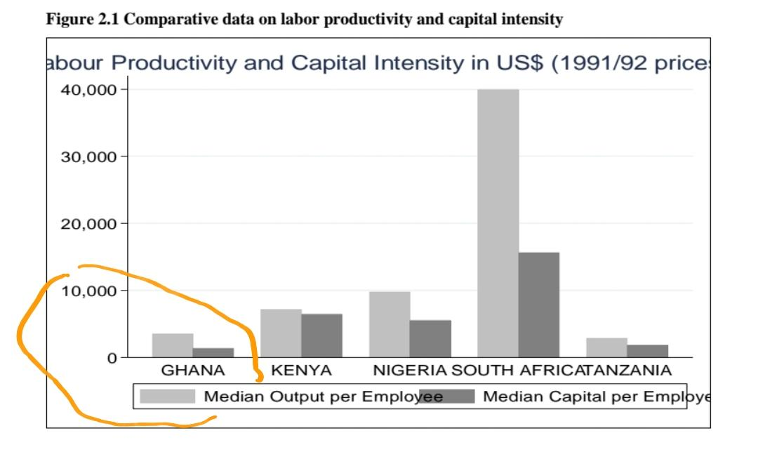
Potential Growth Rate: Working Age Population & Productivity

Slide 13
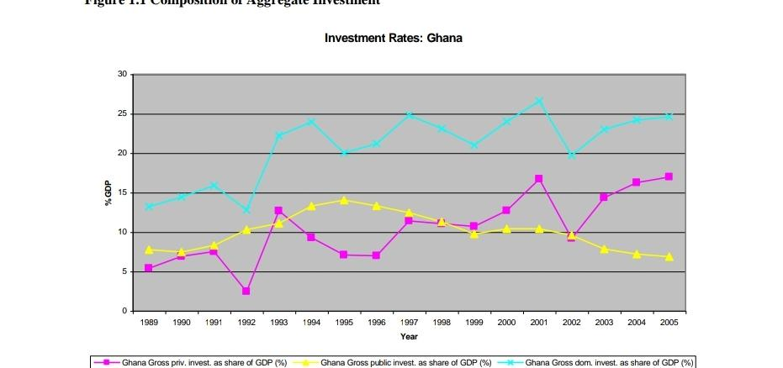
Warranted Growth Rate: Investment

Slide 14
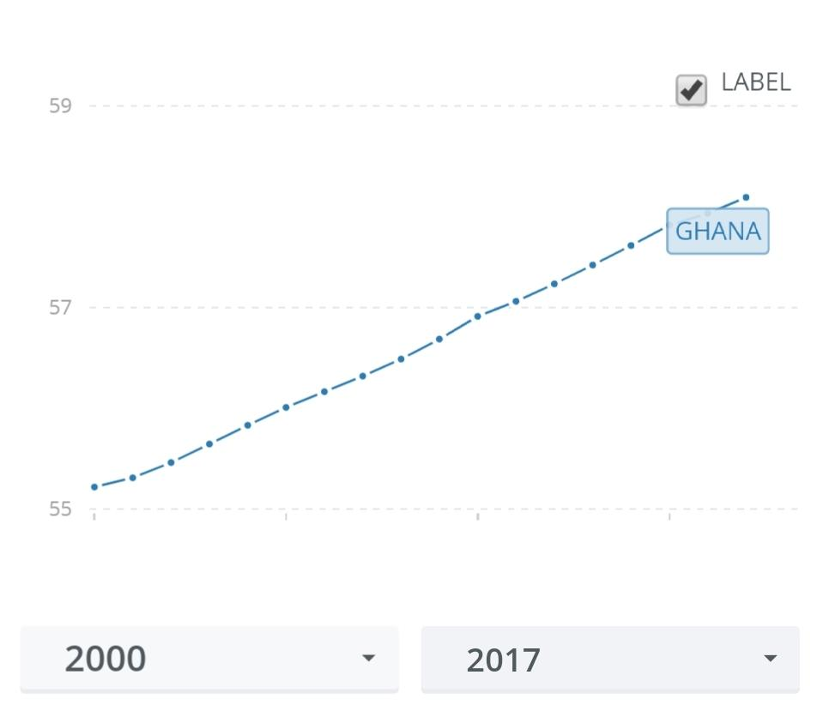
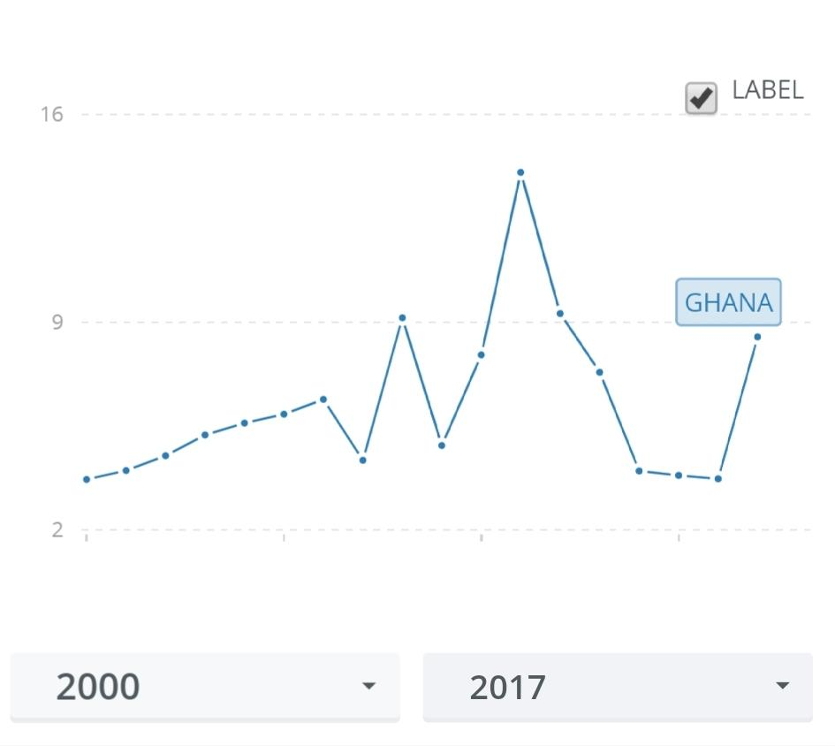
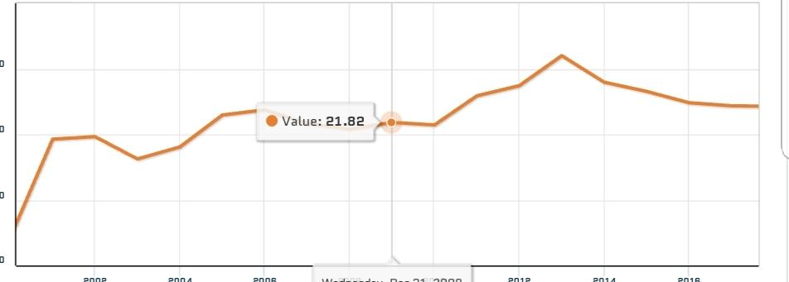
Do we see connections??

Slide 15
Issues and Problems
Availability of data
Overdepence on human capital?
Informal sector?

Slide 16
So Whats Good with Ghana?
What does can PK predict?
How is Ghana doing?
What do others say?

Slide 17
The End
Questions?

